Slide 1


Slide 2


Dataset & Goal
Data Set Characteristics: | Multivariate | Number of Instances: | 299 | Area: | Life
Attribute Characteristics: | Integer, Real | Number of Instances: | 13 | Data Donated: | 2020-02-05
Associated Tasks: | Classification, Regression, Clustering | Missing Values: | N/A | Number of Web Hits: | 119014
Data collection was from April to December 2015. All patients are from Pakistan
The dataset was elaborated by Krembil Research Institute, Toronto, Canada
Goal
Features necessary for heart fail survival prediction
Optimal model with optimal tuning
Trouble shooting when training models on small datasets

Slide 3
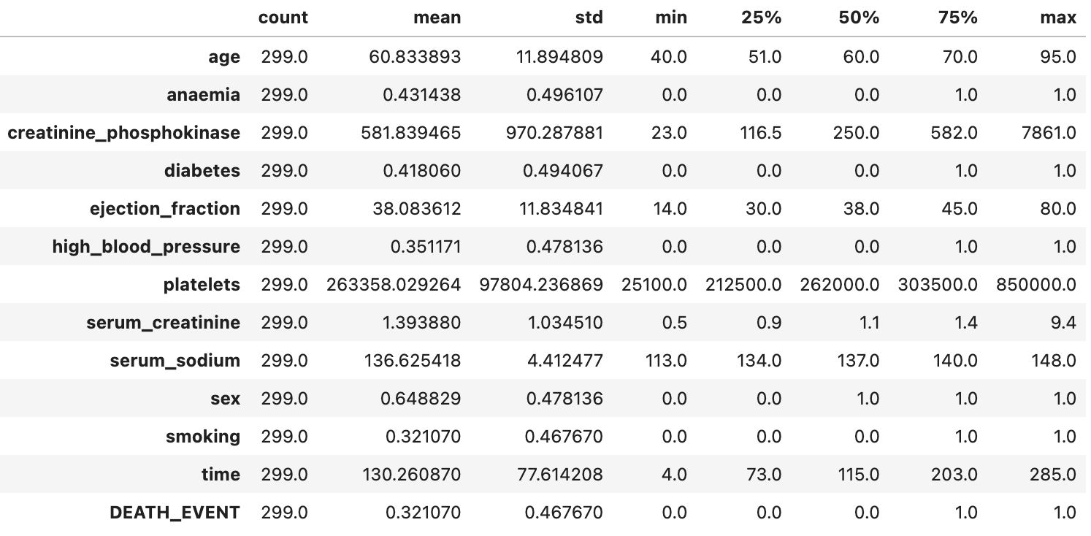
No missing values

Slide 4
Features in the Dataset
Num | Features | Descriptions | Types | Symbols
1 | Age | Age of the patient (years) | Continuous | AGE
2 | Creatinine phosphokinase | Level of CPK enzyme in the blood (mcg/L) | Continuous | CPK
3 | Ejection fraction | Percentage of blood leaving | Continuous | EFR
4 | Platelets | Platelets in the blood (kiloplateles/mL) | Continuous | PLA
5 | Serum creatinine | Level of creatinine in the blood (mg/dL) | Continuous | SCR
6 | Serum sodium | Level of sodium in the blood (mEq/L) | Continuous | SSO
7 | Time | Follow-up period (days) | Continuous | Time
8 | Anemia | 0 = No, 1 = Yes | Categorical | ANA
9 | Diabetes | 0 = No, 1 = Yes | Categorical | DIA
10 | High blood pressure | 0 = No, 1 = Yes | Categorical | HBP
11 | Sex | 0 = Female, 1 = Male | Categorical | SEX
12 | Smoking | 0 = No, 1 = Yes | Categorical | SMO
13 | Death event | 0 = No, 1 = Yes | Categorical | Target

Slide 5
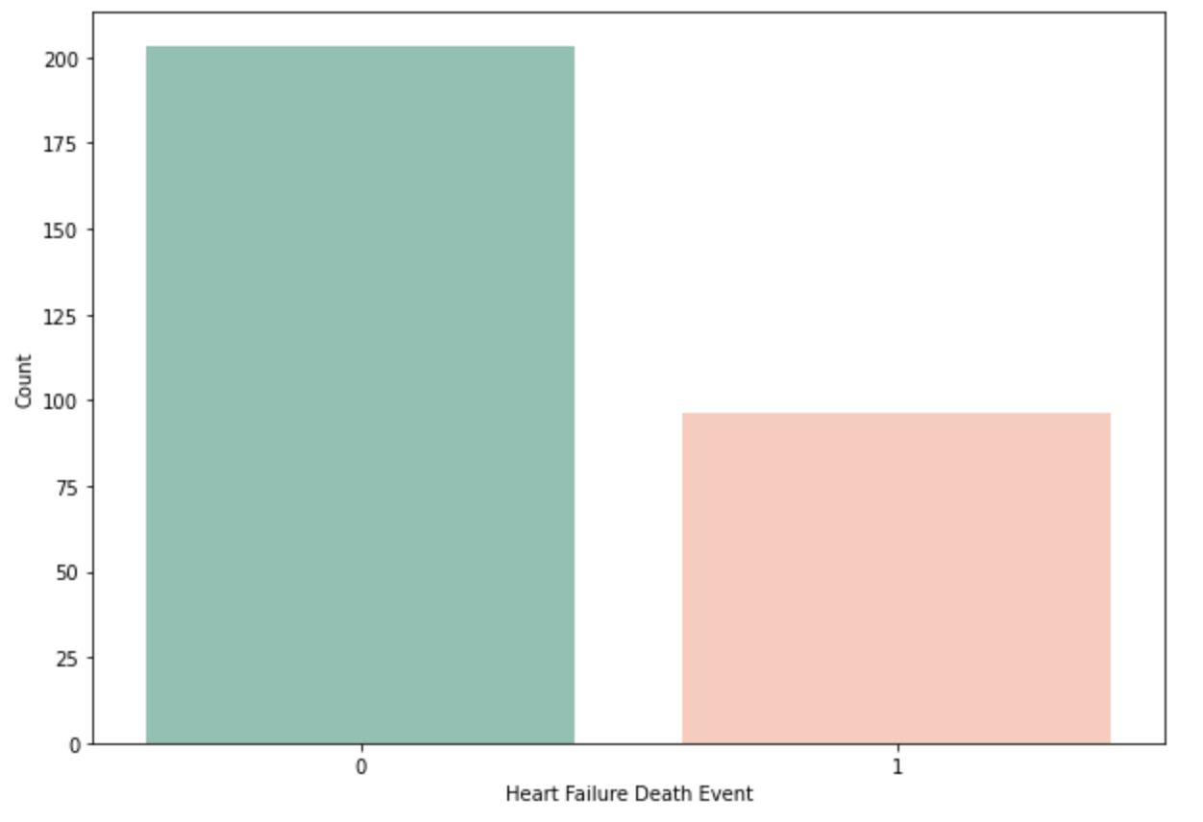
Target
There is an imbalance in the dataset

Slide 6
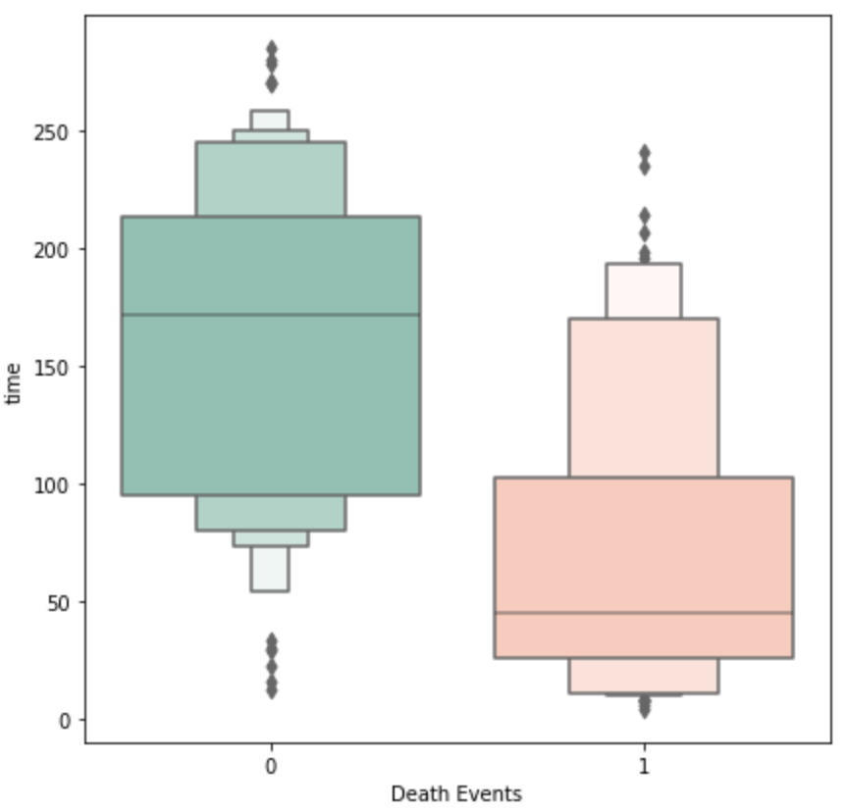
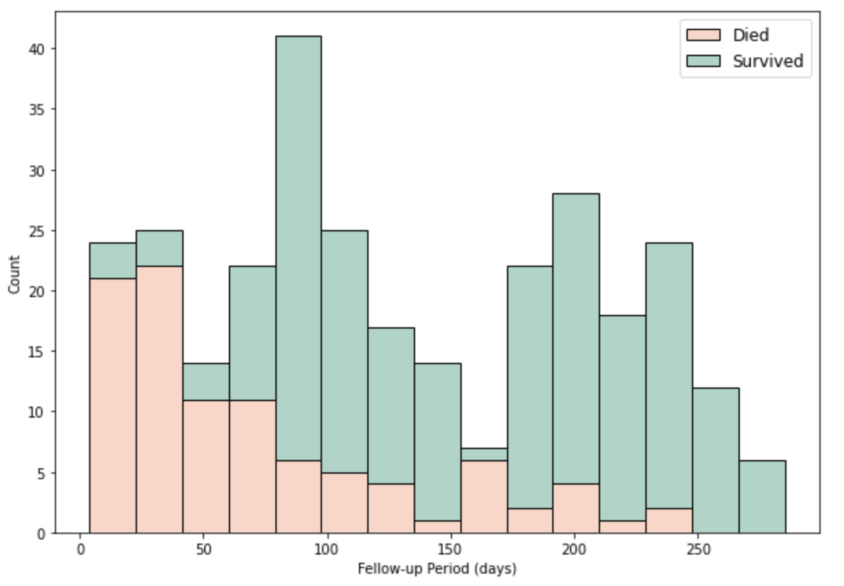
Time Feature
Remove
Follow up time was 4–285 days
High intensity of mortality in the initial days
High correlation with survival
Meaningless for predicting survival

Slide 7
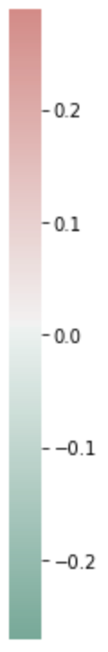
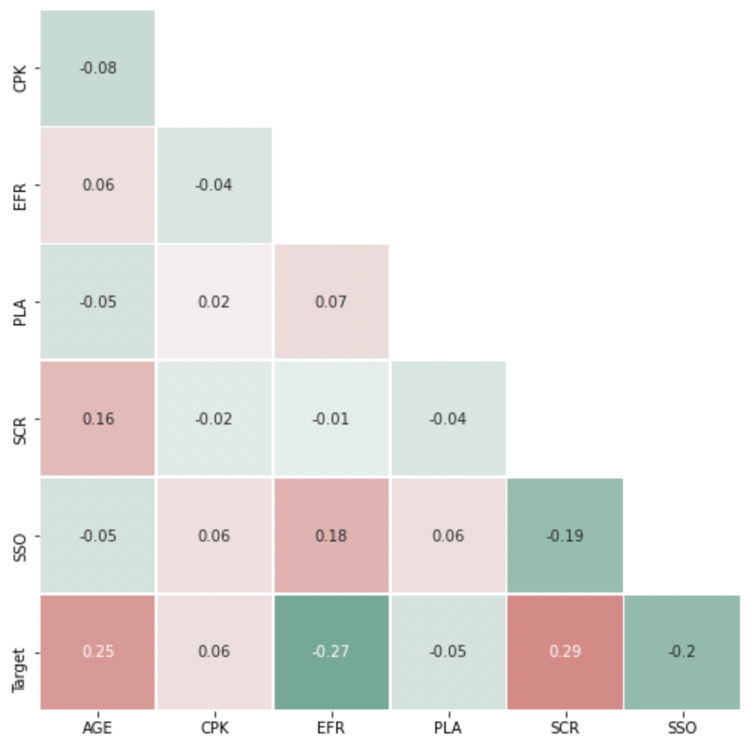
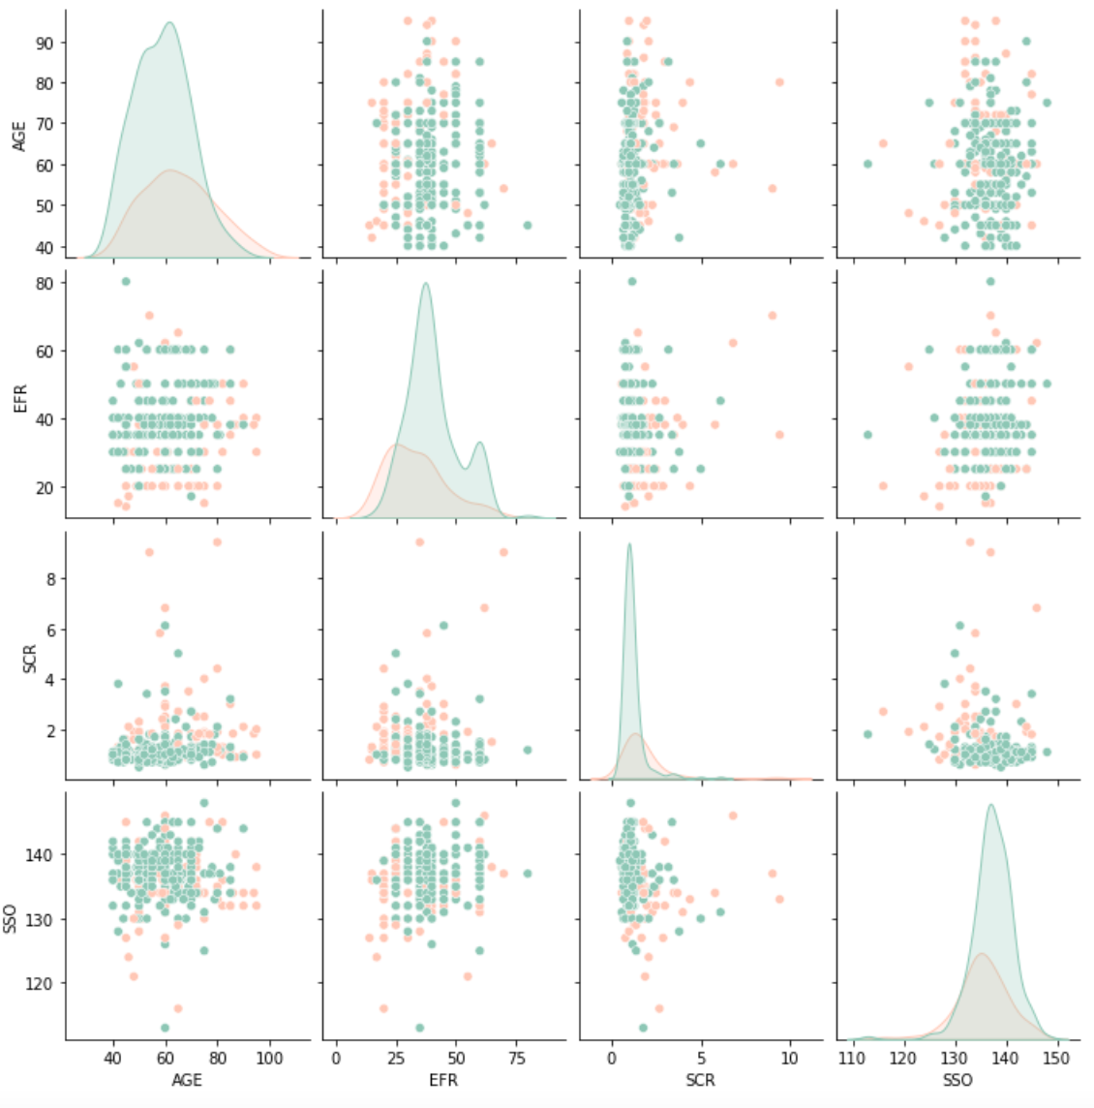
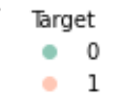
Continuous Features
Model | 6 features | 4 features
Logistic regression | 0.743750 | 0.765481
Decision tree | 0.789808 | 0.808606
Random forest | 0.842644 | 0.851779
XGBoost | 0.830240 | 0.848654
GradientBoost | 0.814808 | 0.848558
Serum creatinine
Ejection fraction
Age
Serum sodium
CPK
Platelets
Low correlation between features

Slide 8
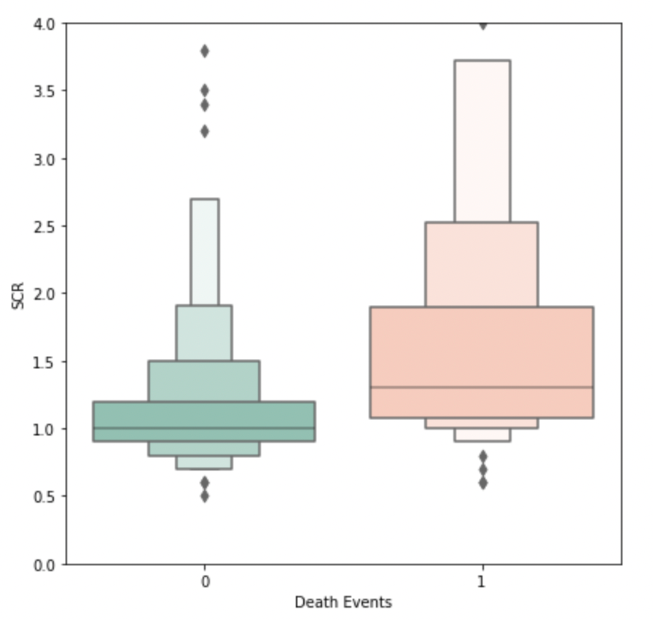
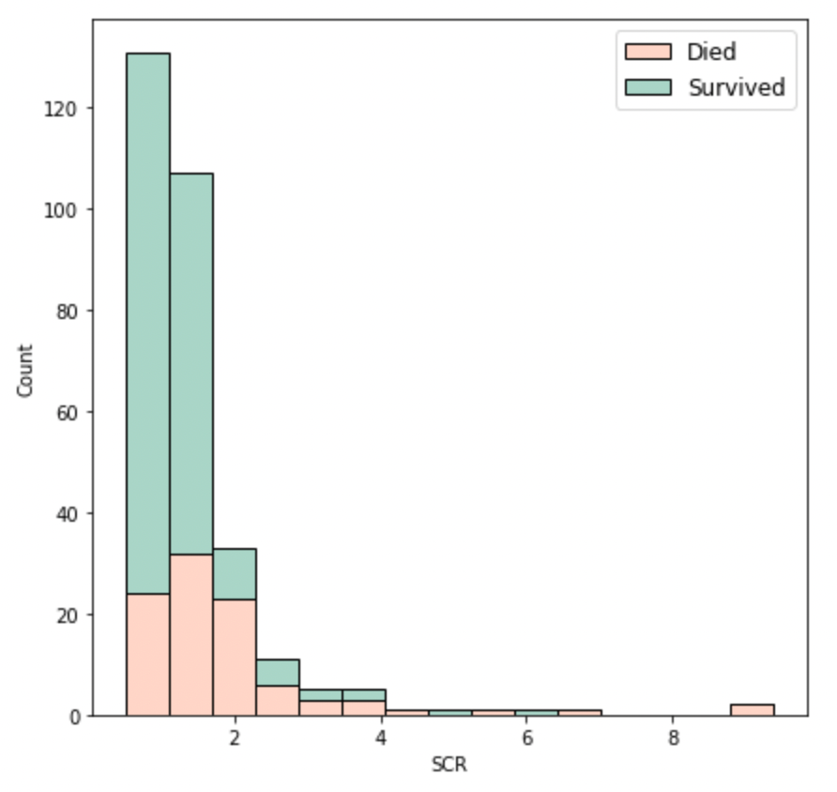
Serum Creatinine
Level of creatinine in the blood (mg/dL)
Normal range: 0.6 - 1.3 mg/dL
Highest record: 73.8 mg/dL
(Persaud et al., 2021)

Slide 9
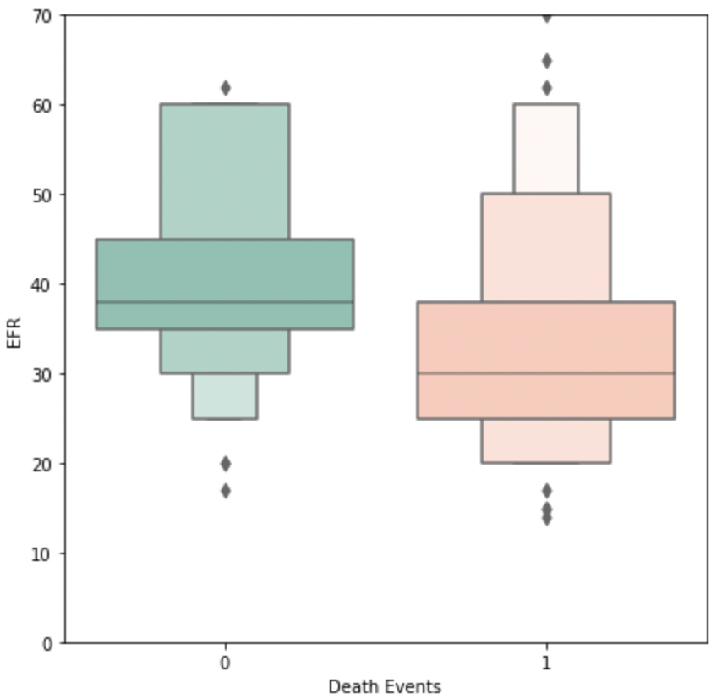
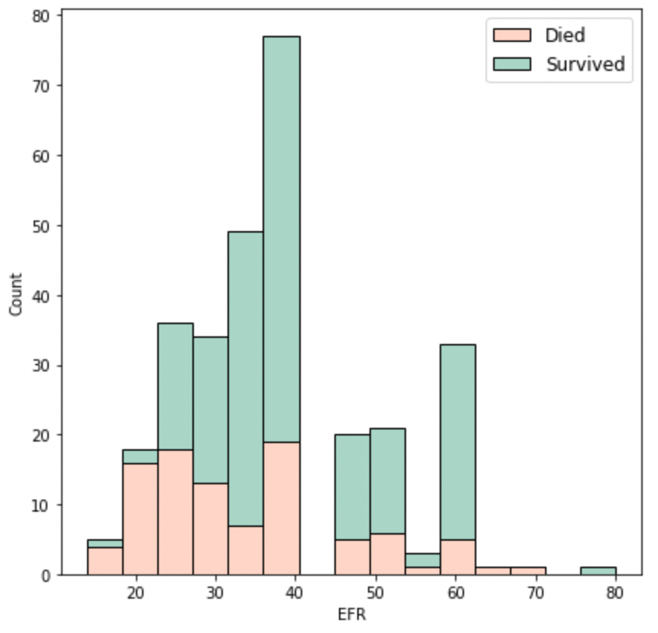
Ejection Fraction
Percentage of blood leaving
Normal range: 50% - 75%

Slide 10
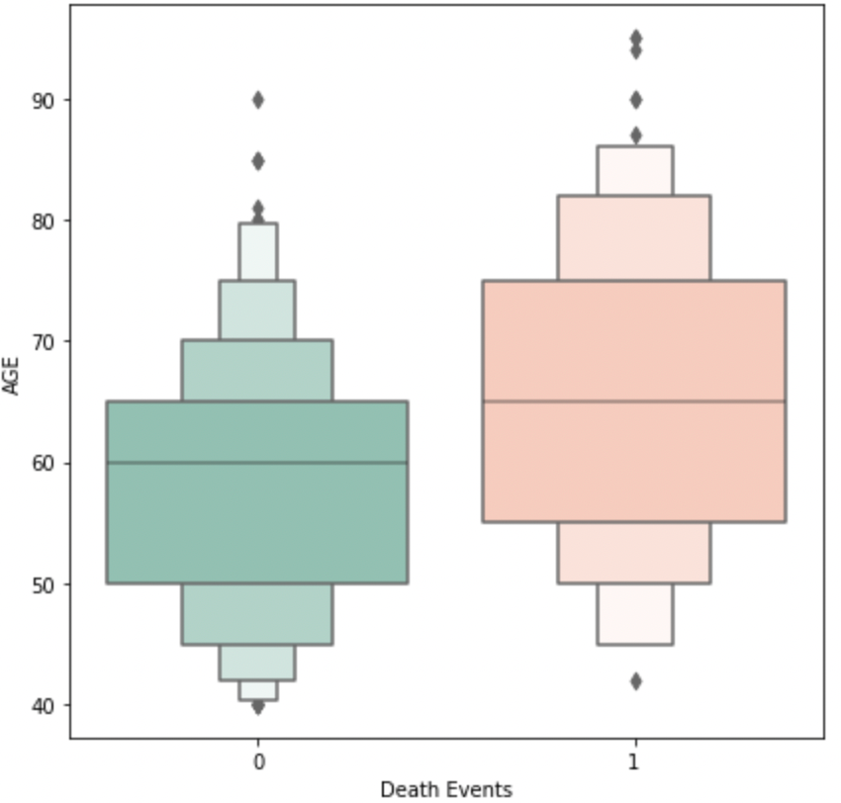
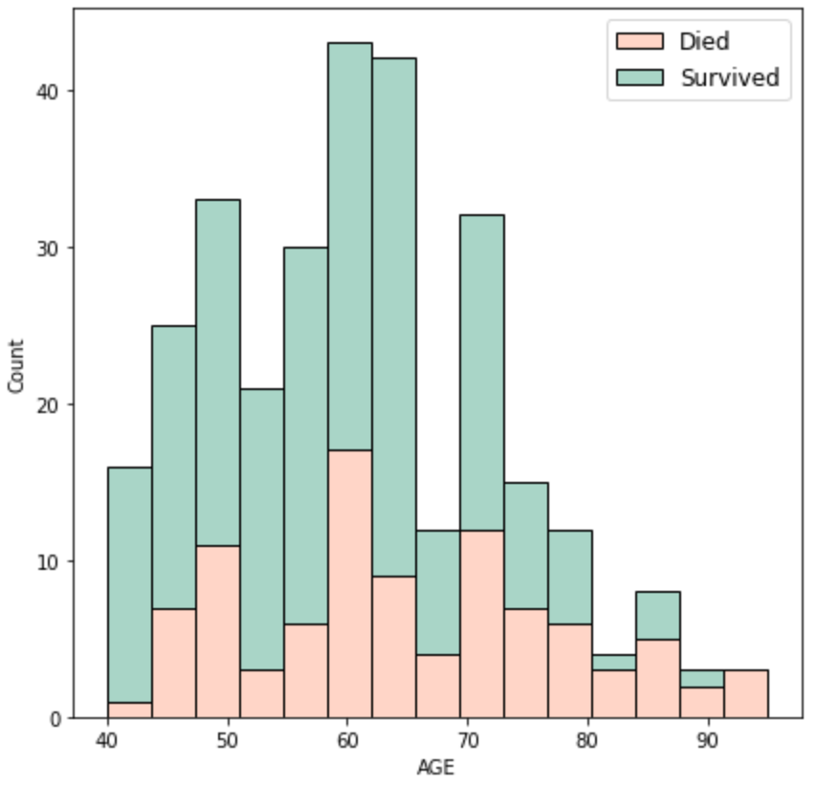
Age

Slide 11
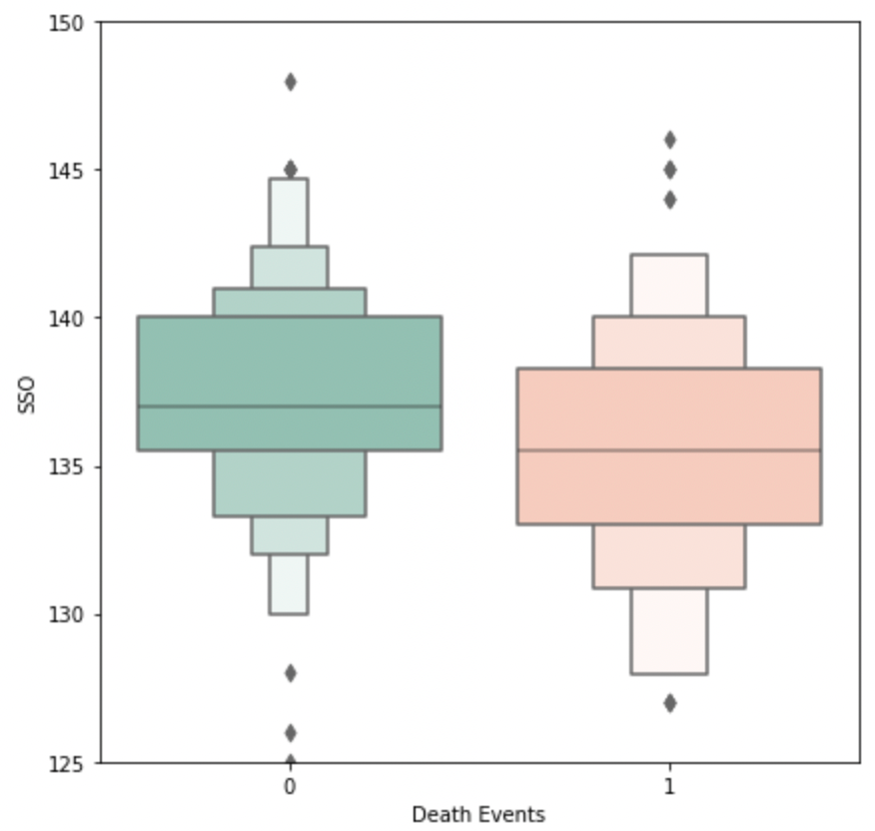
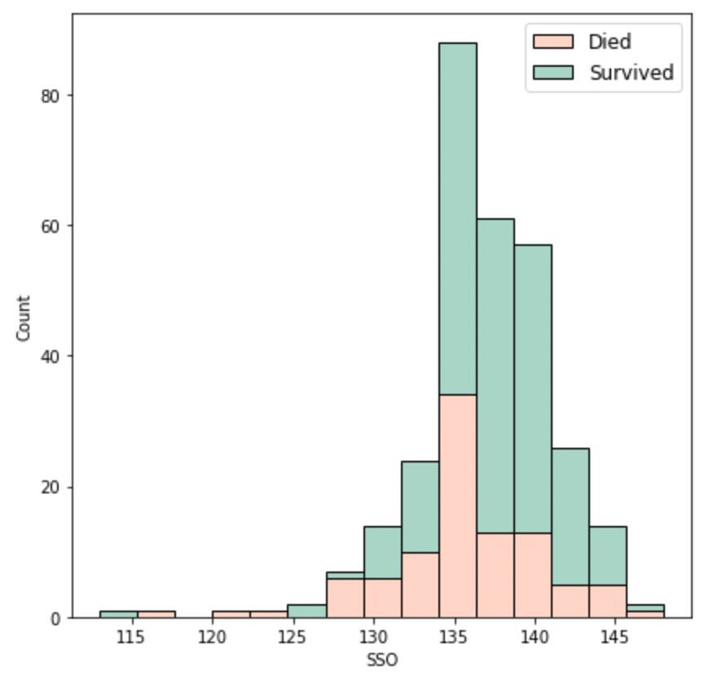
Serum Sodium
Level of sodium in the blood (mEq/L)
Normal range: 135 - 145 mEq/L

Slide 12
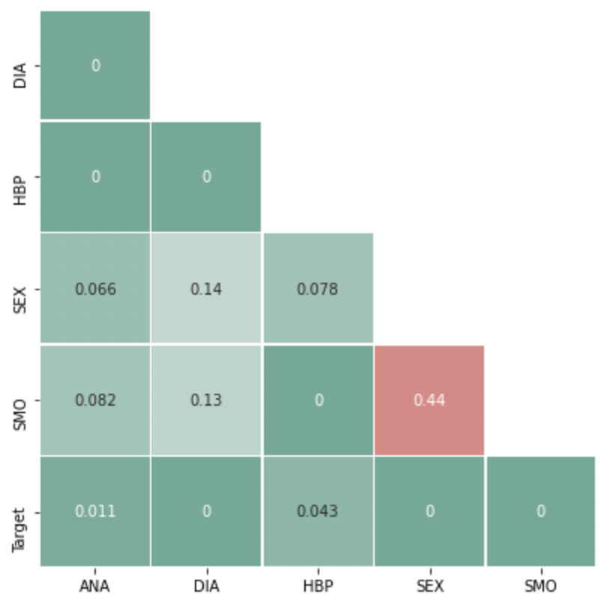
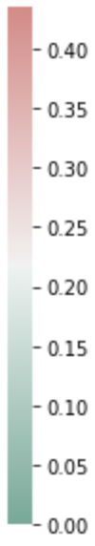
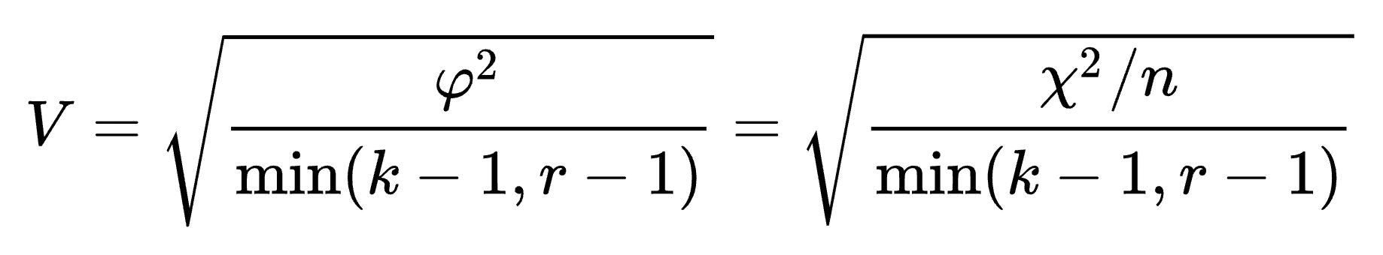
Categorical Features
High Blood Pressure
Anemia
Cramér's V
A measure of association between two nominal variables
Diabetes
Sex
Smoking
Model | 6 features | 4 features
Logistic regression | 0.762452 | 0.765481
Decision tree | 0.796202 | 0.808606
Random forest | 0.842500 | 0.851779
XGBoost | 0.833221 | 0.848654
GradientBoost | 0.827067 | 0.848558
Removing has no effect on the performance of the model
Removing a feature can improve future data collection efficiency
Removing a feature can speed up training
Remove

Slide 13
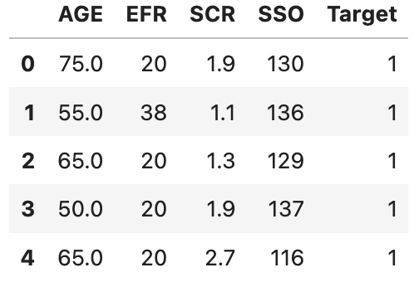
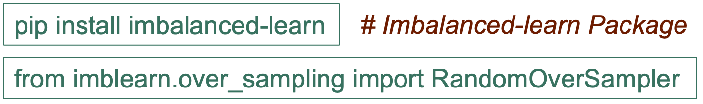
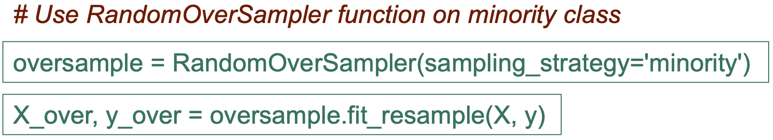
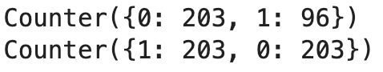
Final Features & Imbalance Issue
Features & target
Death | 1 | 96
Survival | 0 | 203
df_copy.head()
Random Oversampling
Generate new samples on minority class
Random sample and replace the current samples
Serum creatinine Ejection fraction
Age Serum sodium
X = df_copy.drop(columns='Target')
y = df_copy['Target']

Slide 14
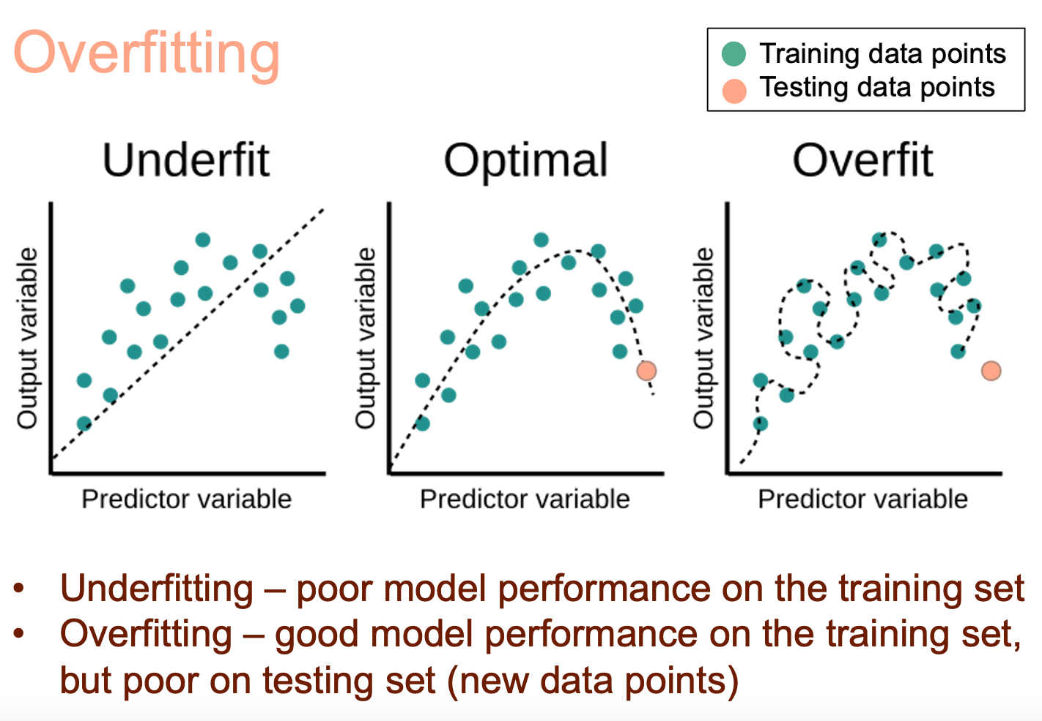
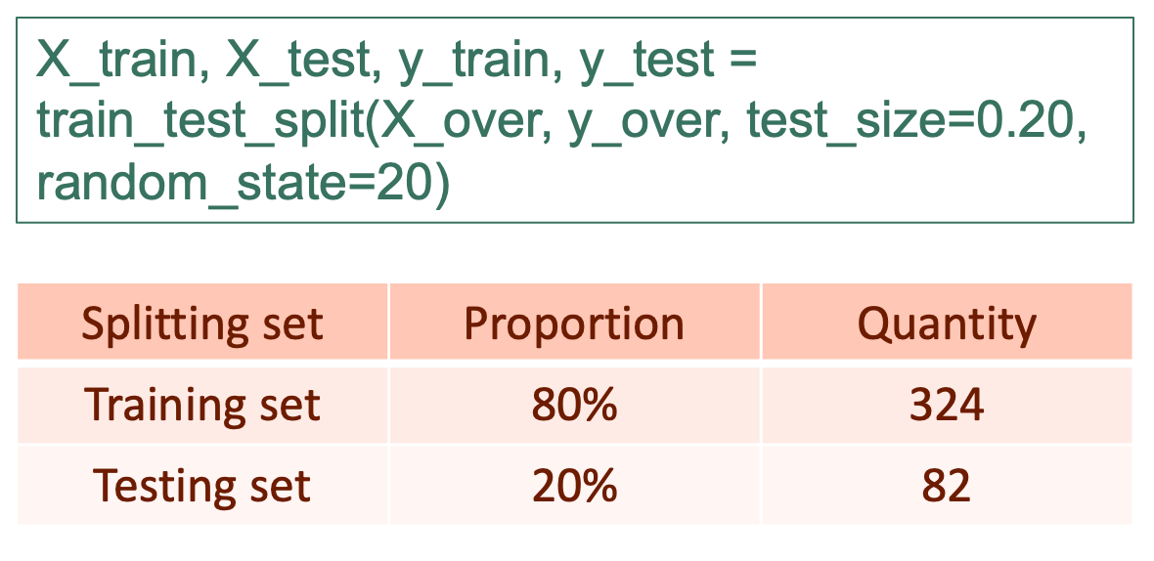
Splitting the Dataset
Create training and testing datasets with different samples
Training set – train the model
Testing set – test the model with new, unseen data points
33
7
163
0
2
40
0
161

Slide 15
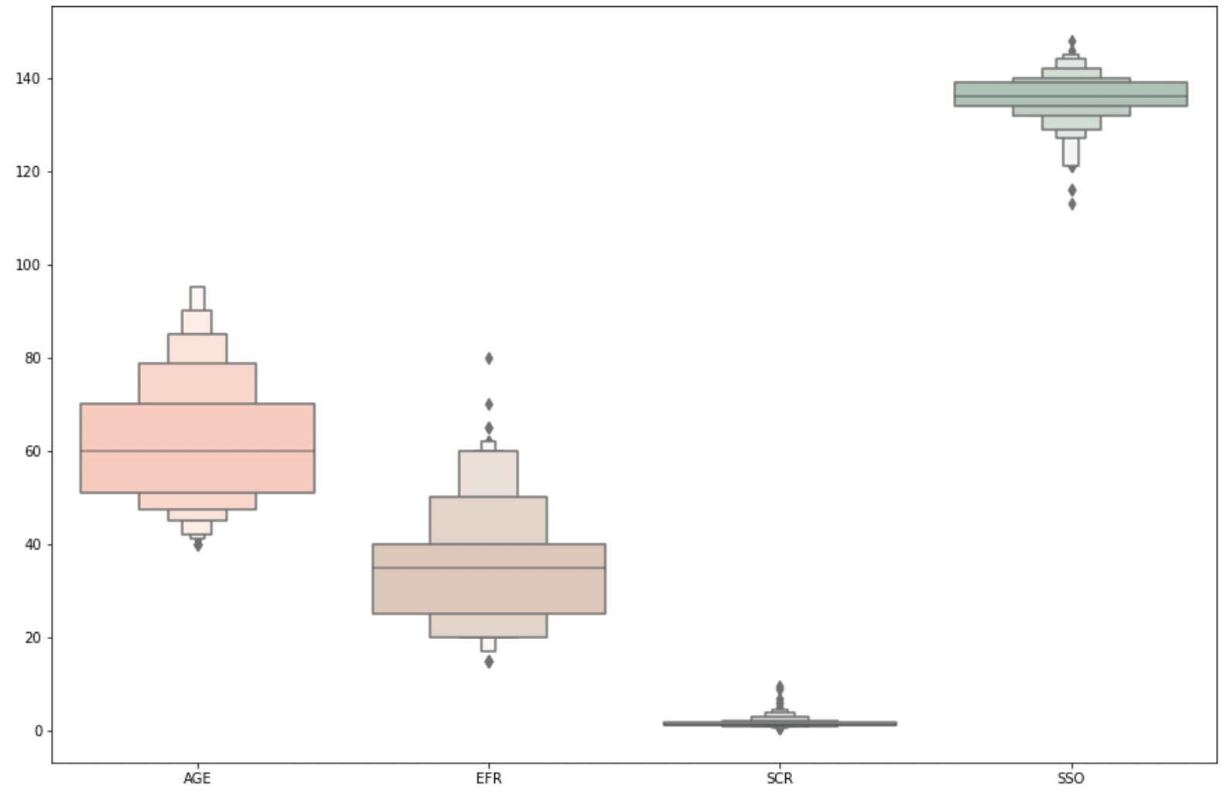

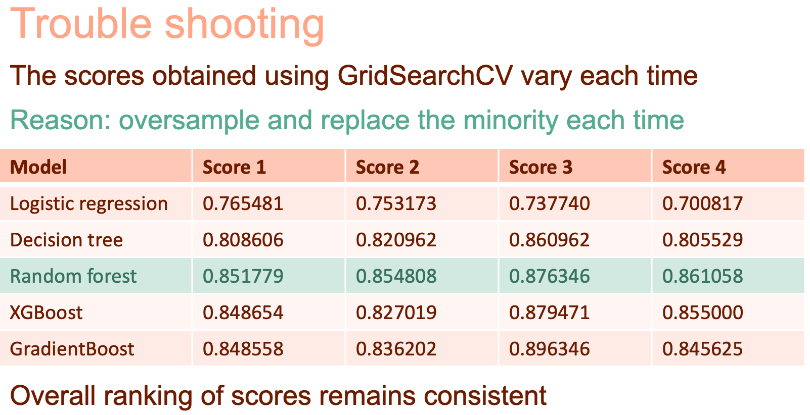
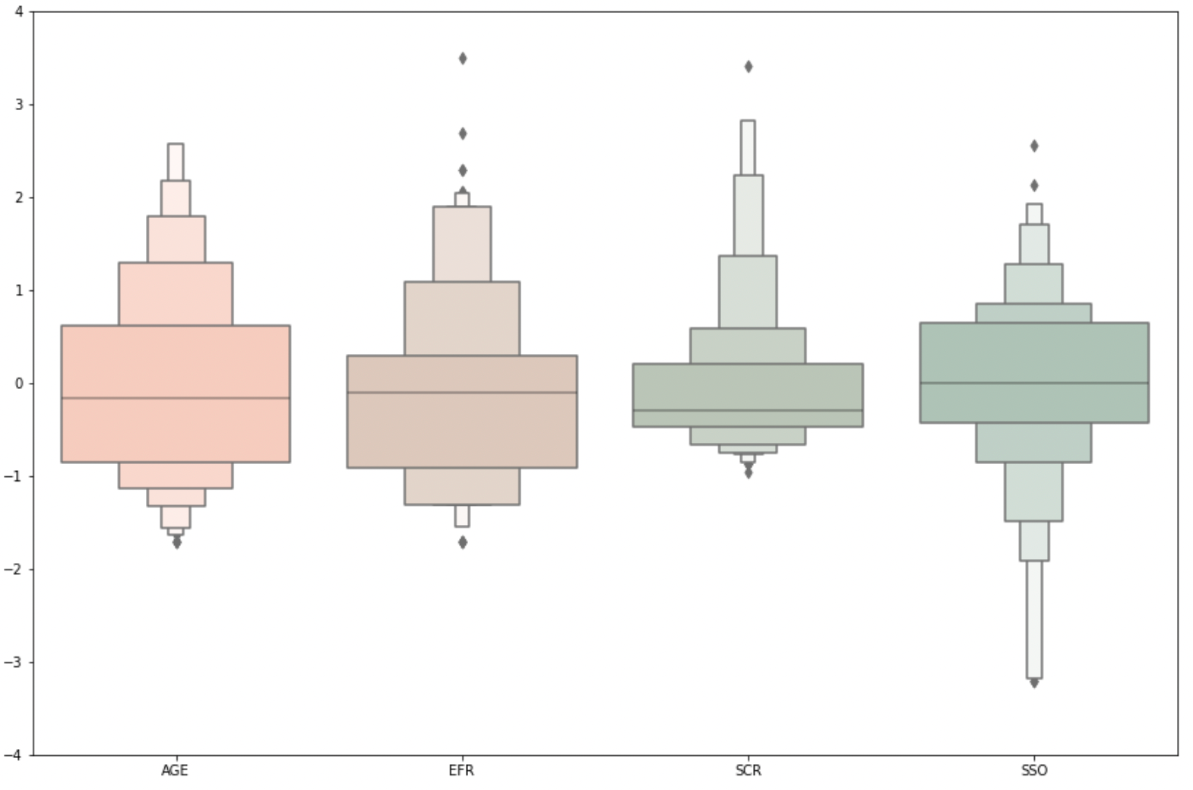
Find Best Model
Standard Scaler
Random Forrest

Slide 16
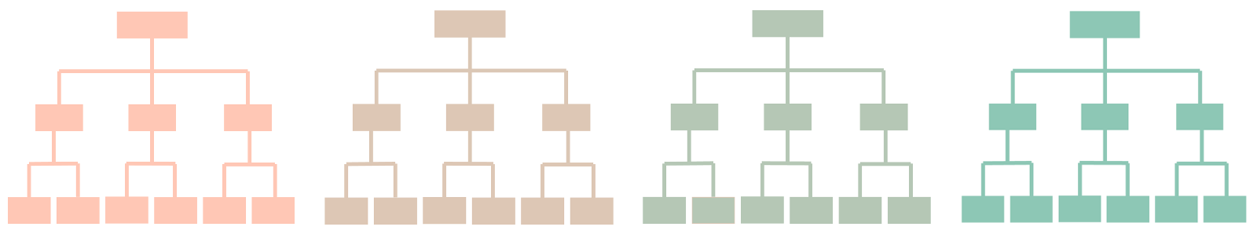
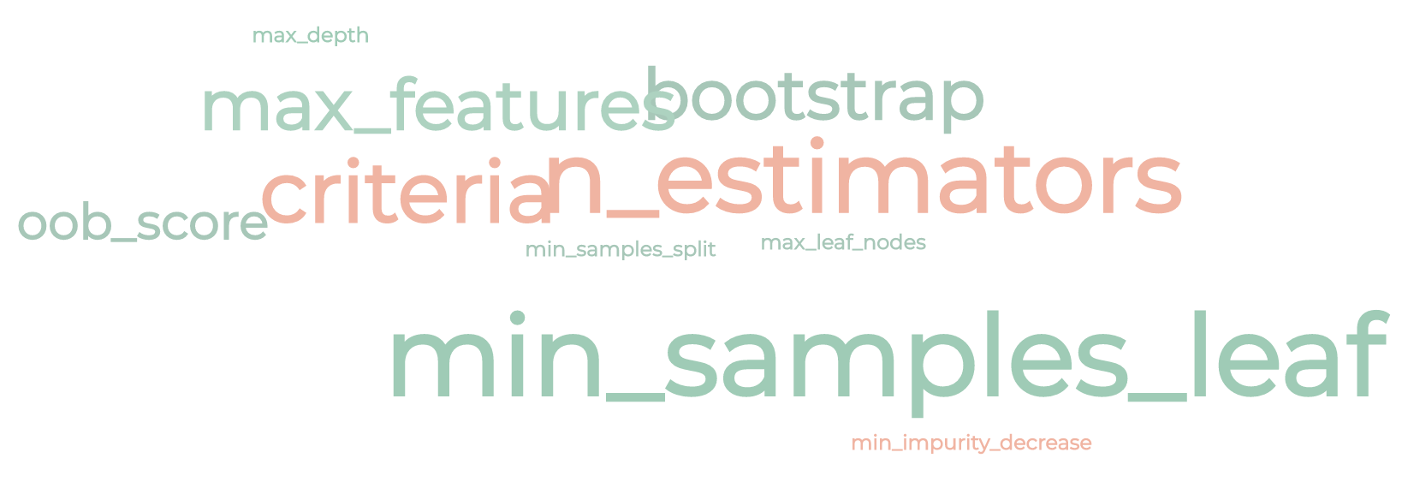
Random Forest & Hyperparameters
33
7
163
0
Hyperparameter is used to control the learning process
2
40
0
Why not try the default values first?
161

Slide 17
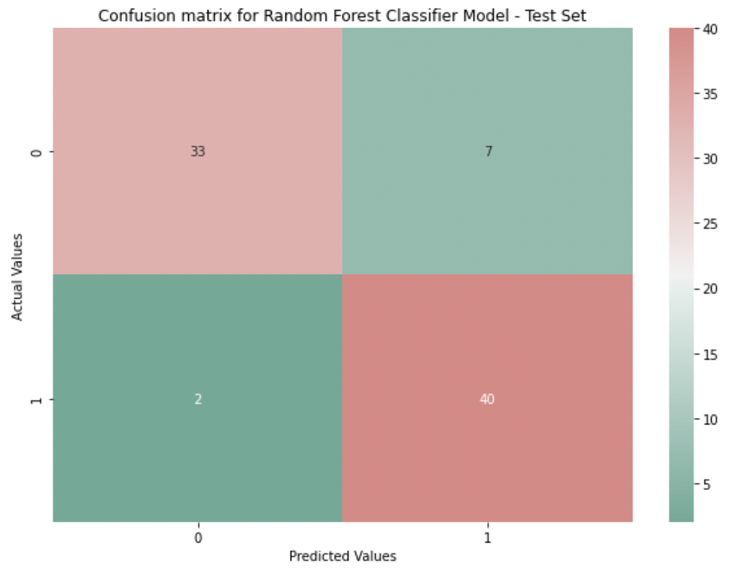
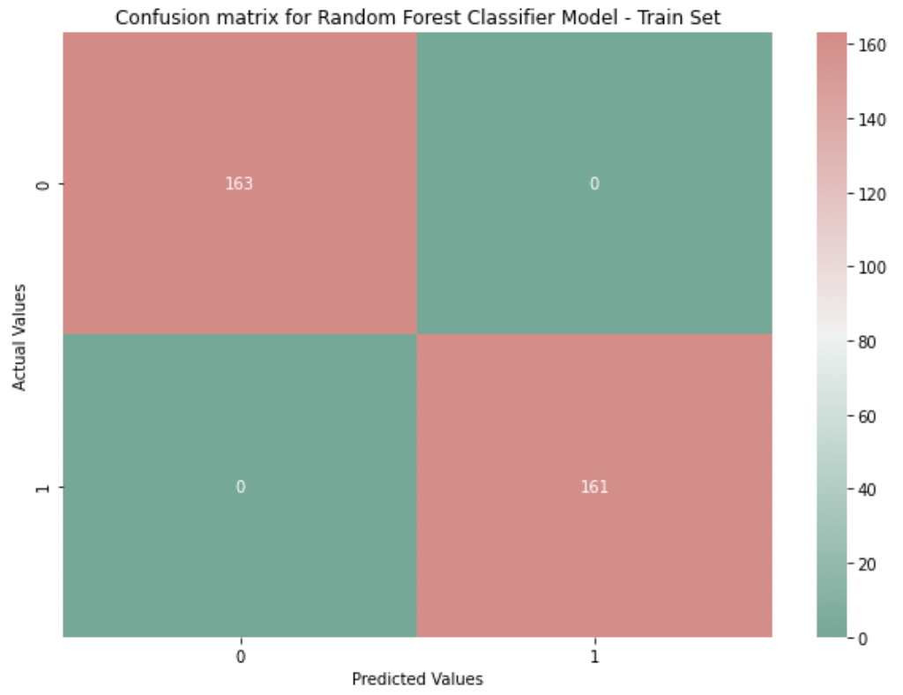
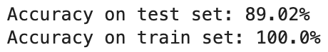
Performance with Default Hyperparameters
33
7
163
0
2
40
0
161
classifier = RandomForestClassifier(random_state=20)
classifier.fit(X_train, y_train)
y_pred = classifier.predict(X_test)
y_train_pred = classifier.predict(X_train)
score = round(accuracy_score(y_test, y_pred),4)*100
score = round(accuracy_score(y_train, y_train_pred),4)*100
Overfitting issue

Slide 18



Hyperparameters
Goals: Less overfitting & better score
n_estimators = number of trees in the forest. Default = 100
max_depth = max number of levels in each decision tree. Default = None
min_samples_leaf = min number of data points allowed in a leaf node. Default = 1
min_samples_split = min number of data points placed in a node before the node is split. Default =2

Slide 19
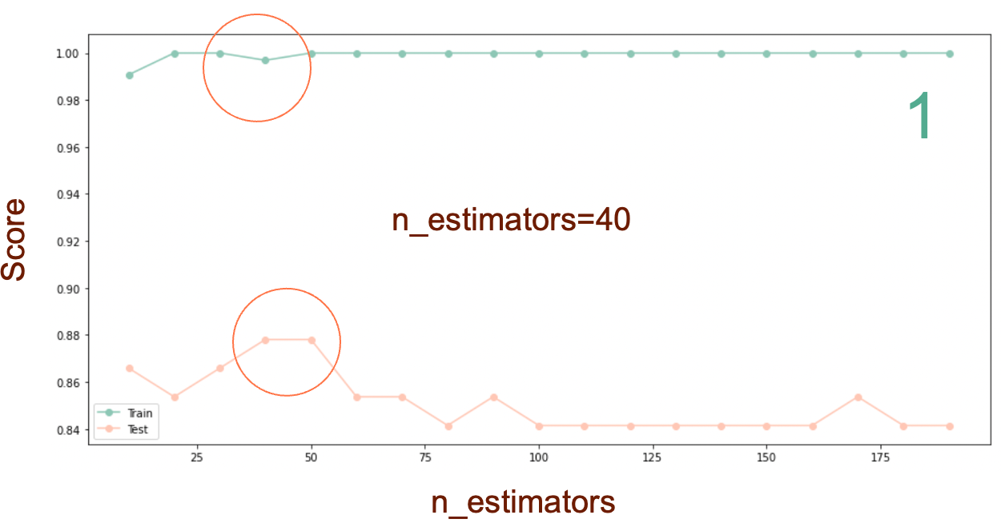
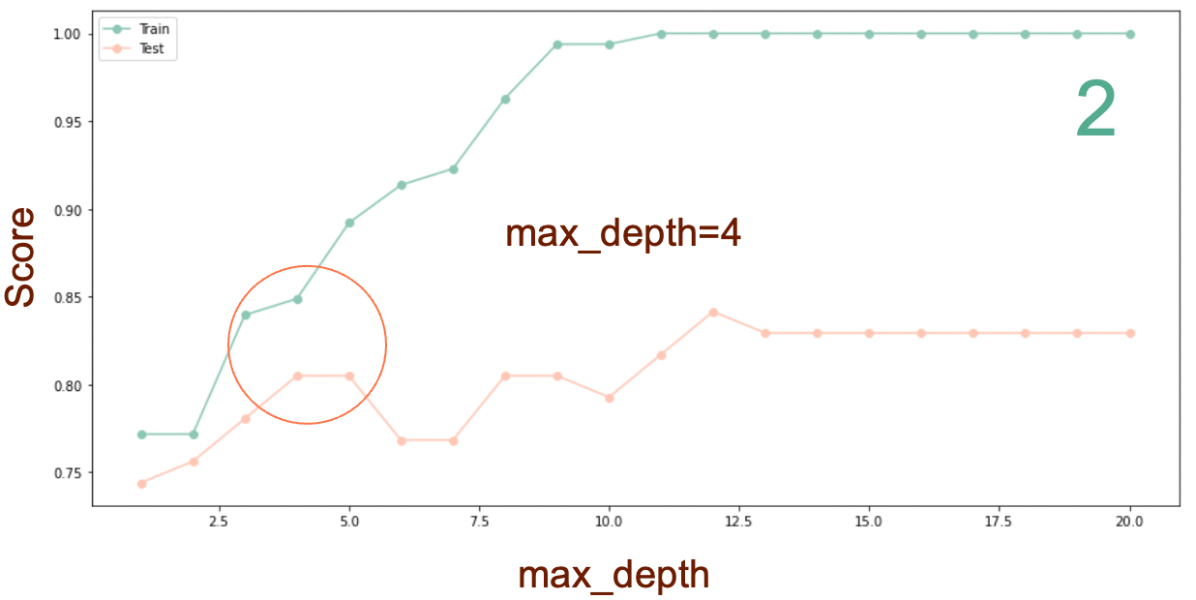
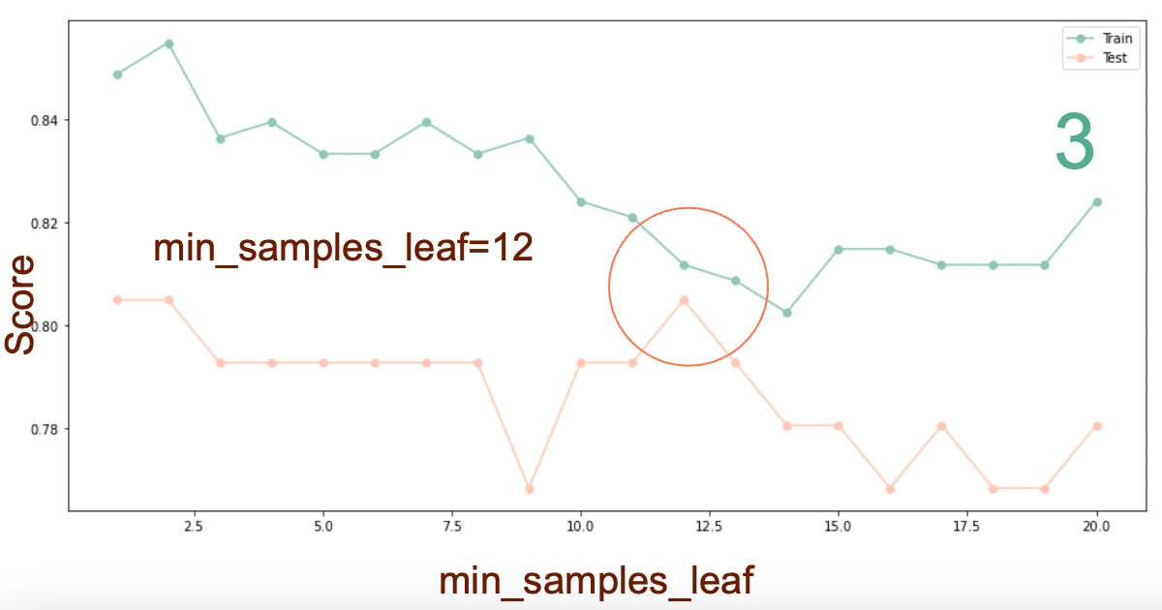
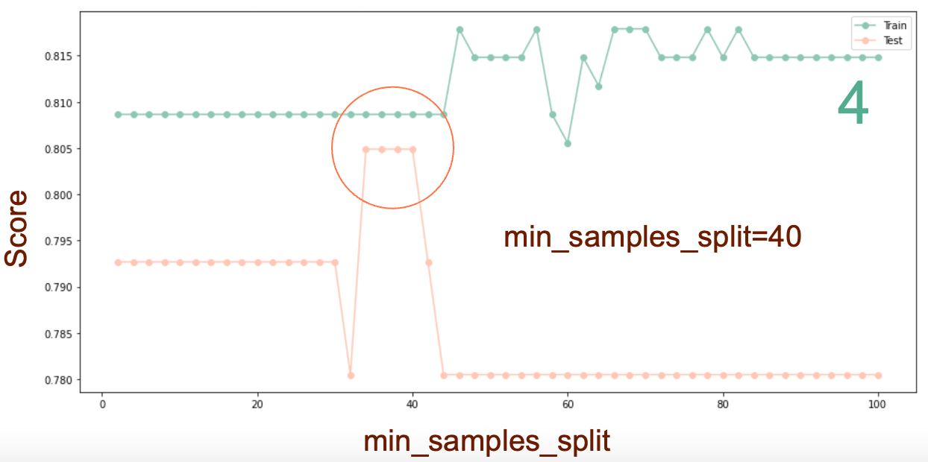
Screening Hyperparameters
Less overfitting & better score

Slide 20
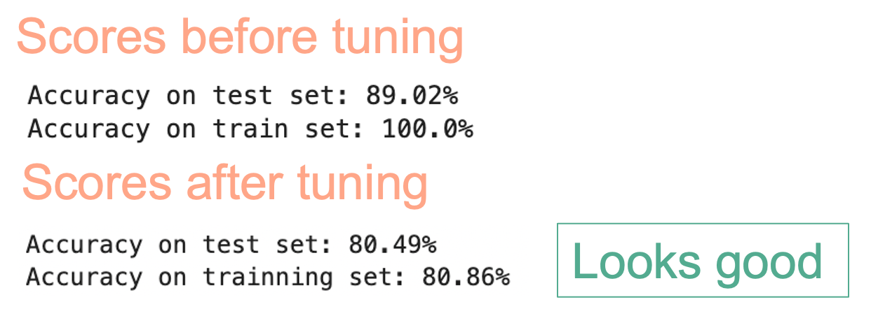
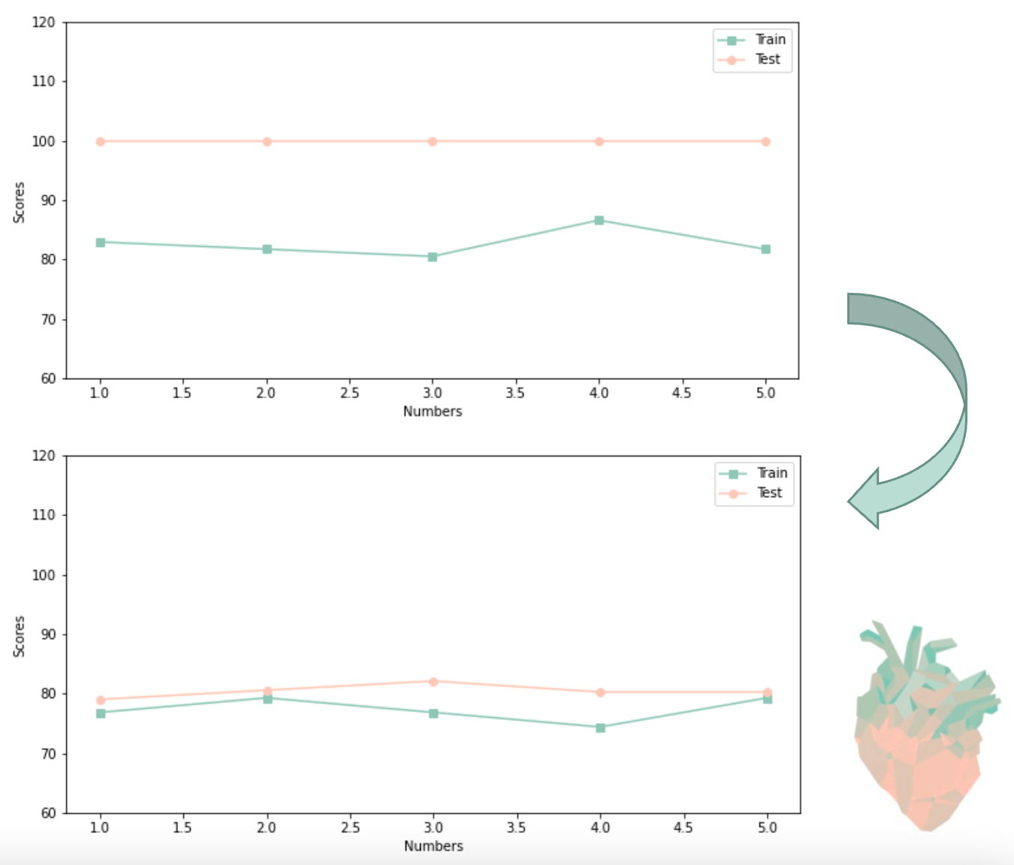
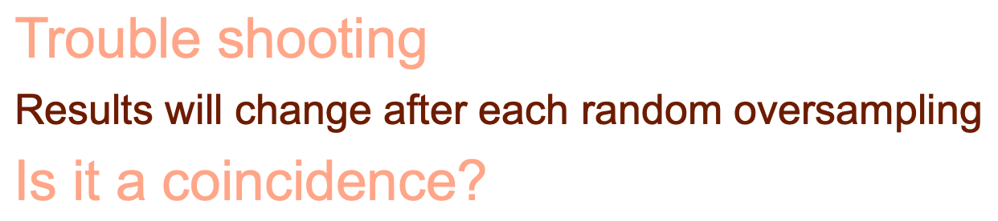
After Tuning the Hyperparameters
33
7
163
0
2
40
0
161
Numbers | Test_before | Train_before | Test_after | Train_after
1 | 82.93% | 100.0% | 76.83% | 79.01%
2 | 81.71% | 100.0% | 79.27% | 80.56%
3 | 80.49% | 100.0% | 76.83% | 82.10%
4 | 86.59% | 100.0% | 74.39% | 80.25%
5 | 81.71% | 100.0% | 79.27% | 80.25%

Slide 21
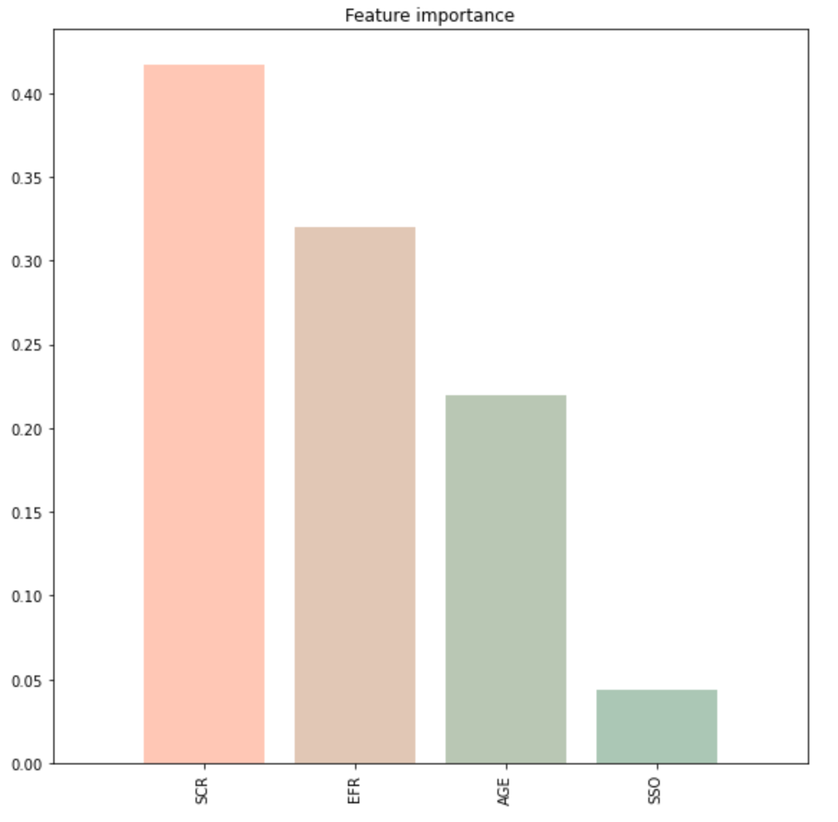
Feature Importance
Can I remove the feature serum sodium?

Slide 22
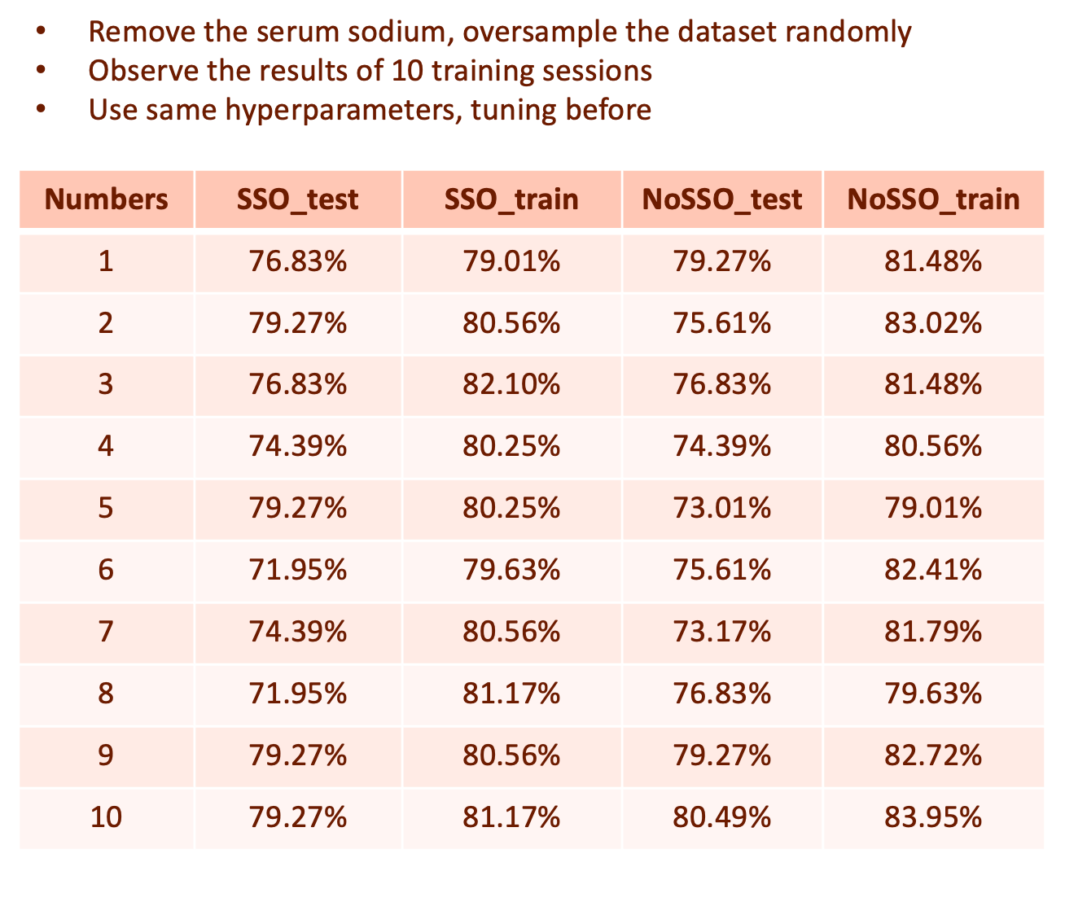
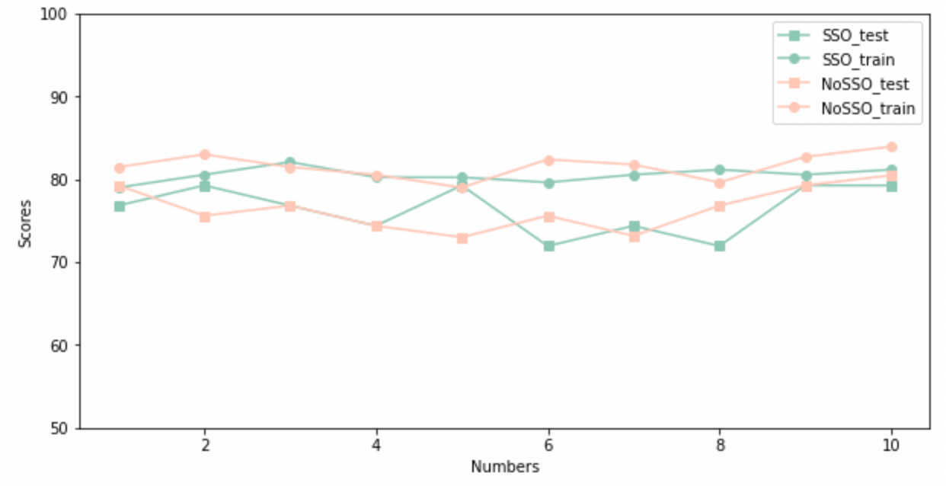
Can I remove the feature serum sodium?
Removing has no effect on the performance of the model
Removing a feature can improve future data collection efficiency
Removing a feature can speed up training
Remove

Slide 23
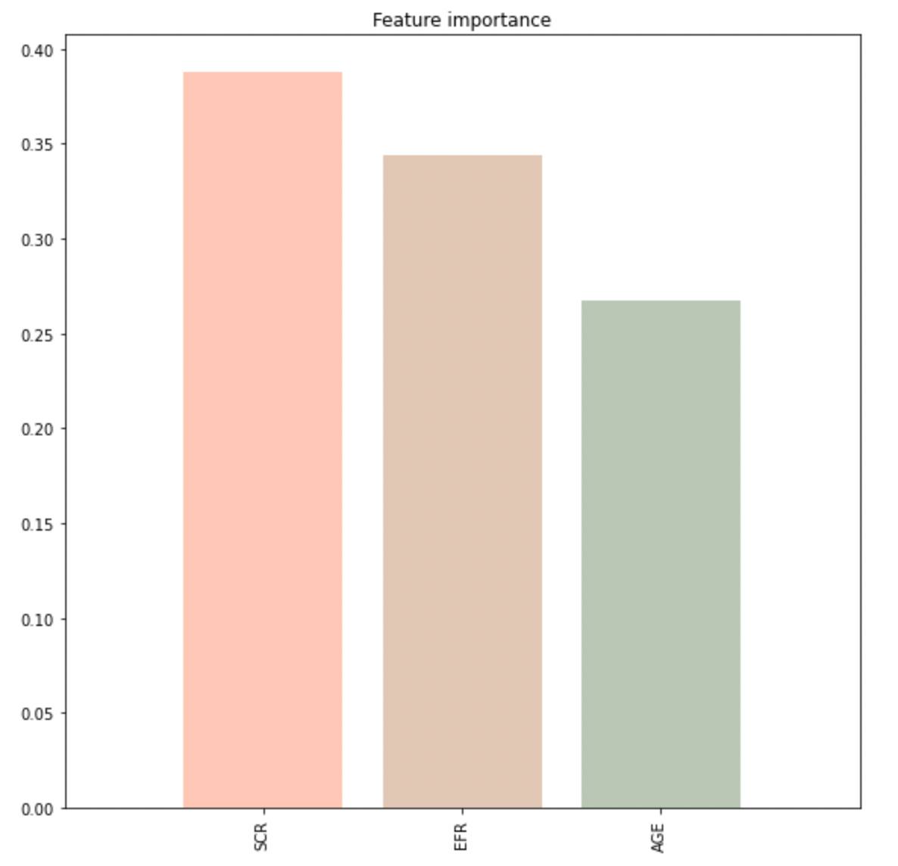
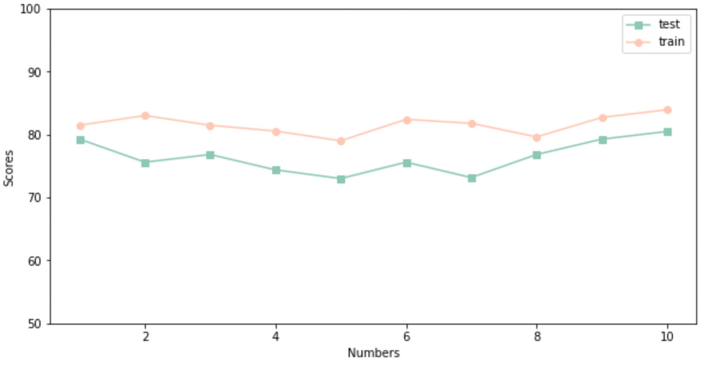
Conclusion
Use random oversampling to resolve imbalances in the dataset
Use 3 features, serum creatinine, ejection fraction and age, to train the model
Tune the hyperparameters:
n_estimators=40, max_depth=4, min_samples_leaf=12, min_samples_split=40
The overfitting problem still exists, but is well improved
Scores on test set remain in the 70-80 range after random oversampling

Slide 24
Thank you
Instructor: Dr. Baloglu

